Slide 1
Car Finder
By Blake Hawkins, Jacqueline Kolze, & Aaron Mayhew

Slide 2
Story Telling
What is the problem?
There aren’t enough car sites.
Who is this for?
Trendy adults who want to buy and sell cars.
How does the app solve the problem?
It’s a fresh new platform that allows people to sell or buy cars without using a dealership.

Slide 3
Motivation
We wanted to create a trendy car app, to help people buy and sell cars.

Slide 4
How Does Car Finder Work?
Car Finder starts off by directing the user to the home page. From there the user has the option to search for cars by filling out optional information on a form. The form asks important questions regarding car buying. These questions ask things like year, model, color, and type of car. Then below the form it shows some featured cars that are replaced by search results once the user submits.
On the add a new car page it lets user’s add a car.

Slide 5
Roles
Jacqueline, did both front end and back end stuff. She did all the design related parts, including the web page layout. She also helped make the app function by writing some of the JavaScript.
Aaron contributed by doing API routing and some JavaScript.
Blake organized the repository and connected the front and back end work that had been done enough to be able to push to Heroku. This required much of the work between the group to be reformatted to actually work once deployed. He also did the HTML routing and some of the API routing along with creating the database models.

Slide 6
Challenges
-Get/post routes, these sucked!
-Testing was also hard.
-Heroku
-Working together, we found it much harder to work together on this project due to the tasks being intertwined rather then separate. Each person spent a lot of time waiting on the others in order to see functionality.

Slide 7
Future Revisions
-We would love to make a favorites section! To make the user experience better.
-Perhaps expanding to RV’s, boats, other vehicles.
-Maybe rentals in the future?

Slide 8
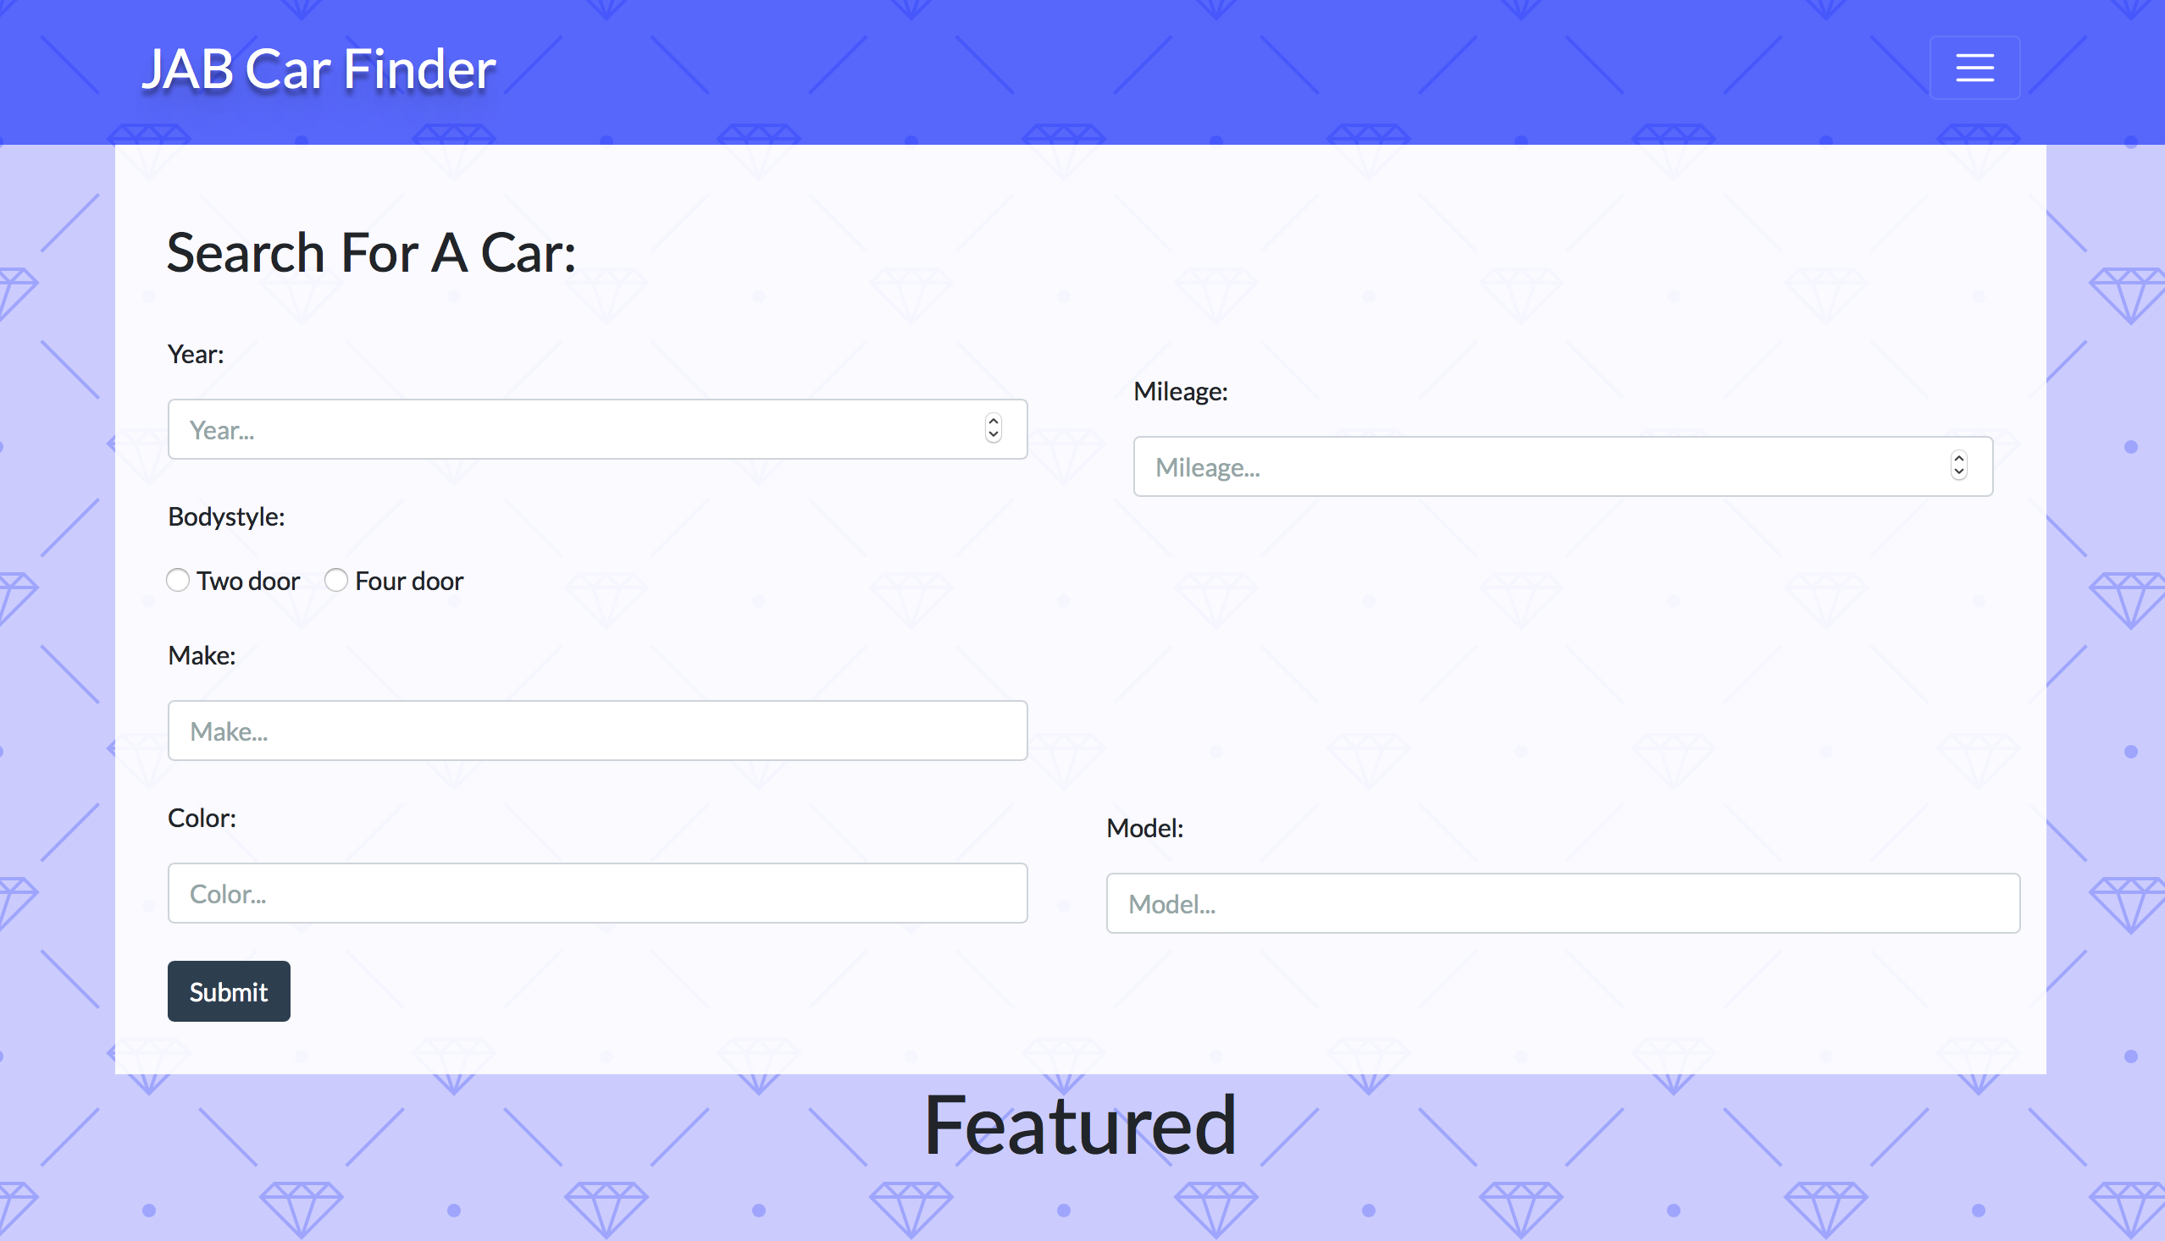
Photos of our project

Slide 9
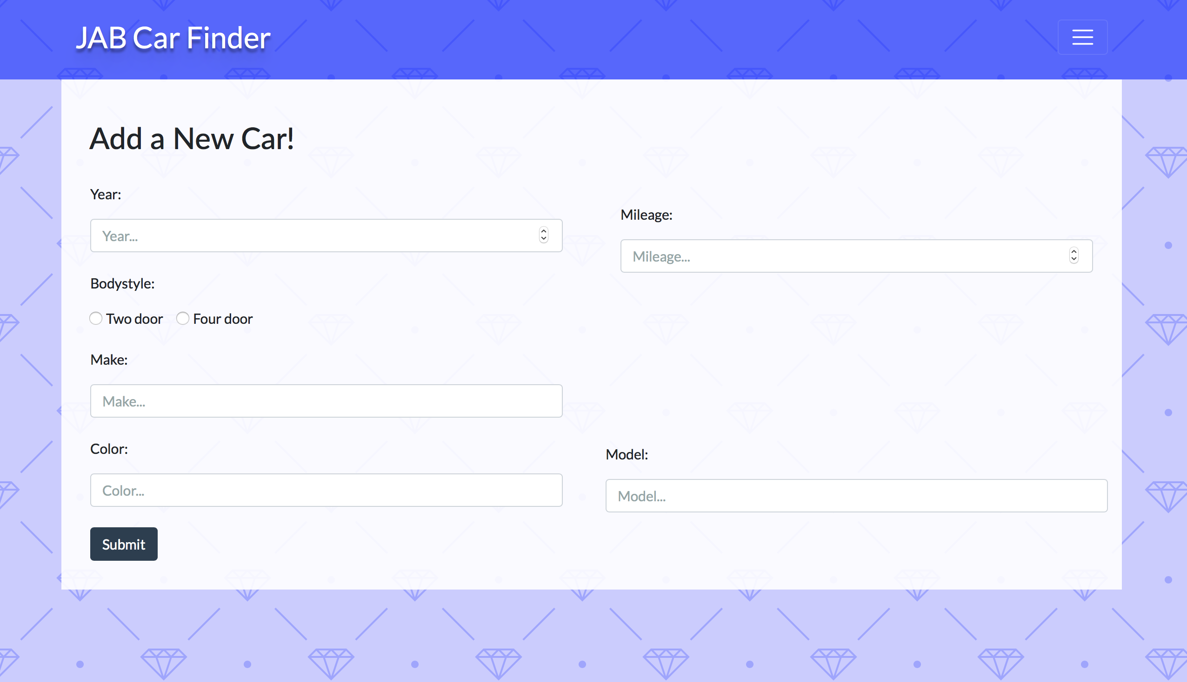
Add A new car

